Slide 1
Network Architectures
A simplified view …

Slide 2
Disclaimer
The purpose of this session is NOT to make you network engineers
We will look briefly at networks, structures of networks and a little bit at protocols
The goal is mainly to give you an overview, with enough understanding to comprehend how it affects architecture and design

Slide 3
Network Topologies
Topology describes the physical network layout
  The physical layout has impact on performance, reliability, and cost
  Currently, many networks are hybrid
https://www.lifewire.com/computer-network-topology-817884

Slide 4
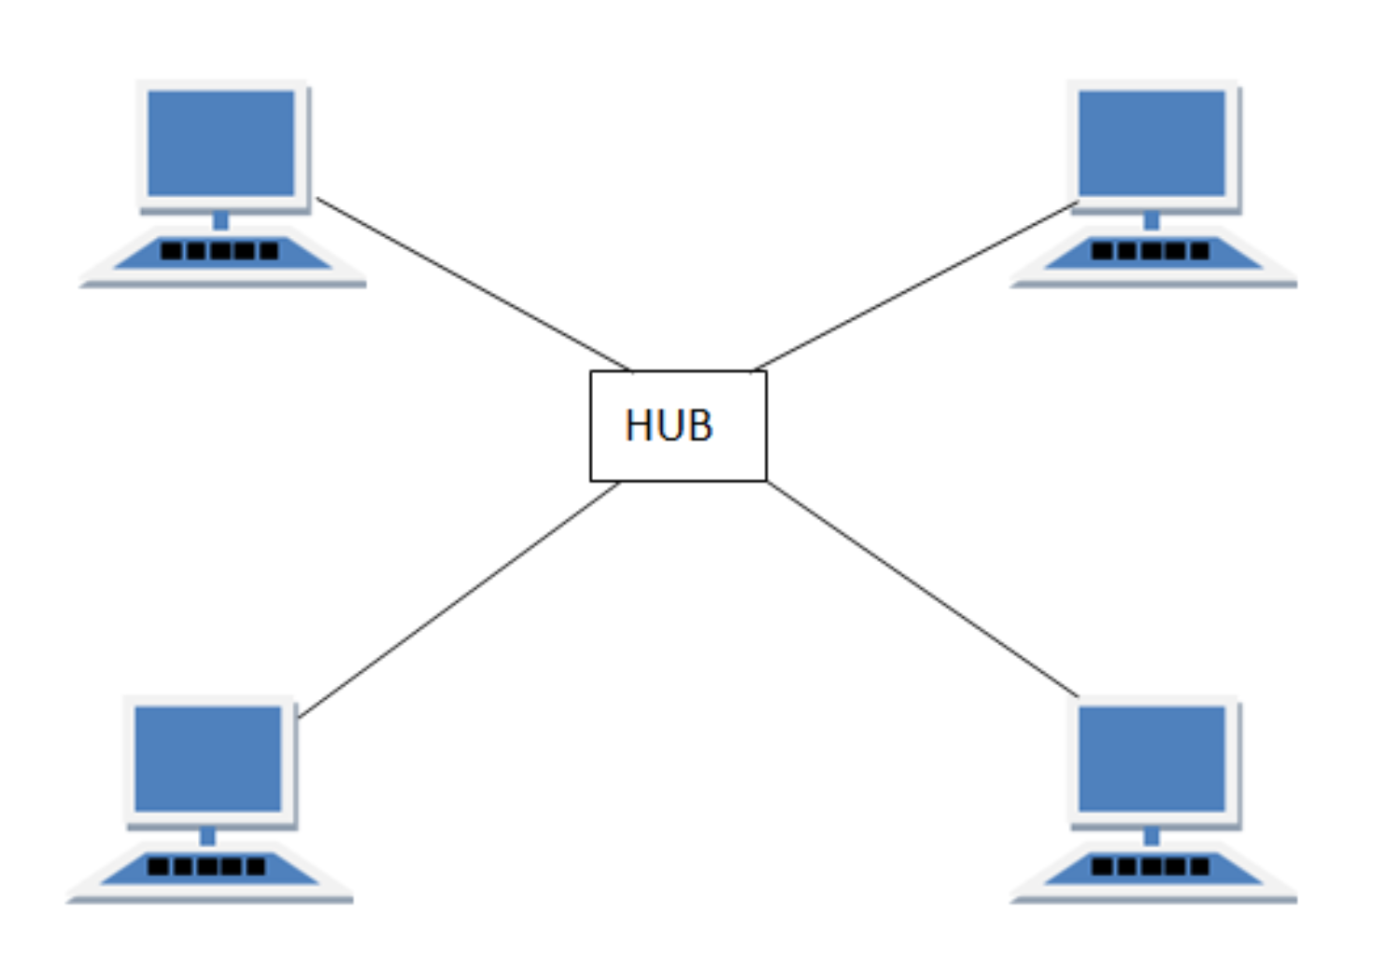
Network Topologies
Star – devices connected to a central hub / switch / router
  Pros:
    Easy to add / remove devices
    Isolated failures
  Cons:
    Single point of failure (SPOF)
    Not scalable
  Usage:
    Home networks & small offices
    Wi-fi / LAN routers
https://www.lifewire.com/computer-network-topology-817884

Slide 5
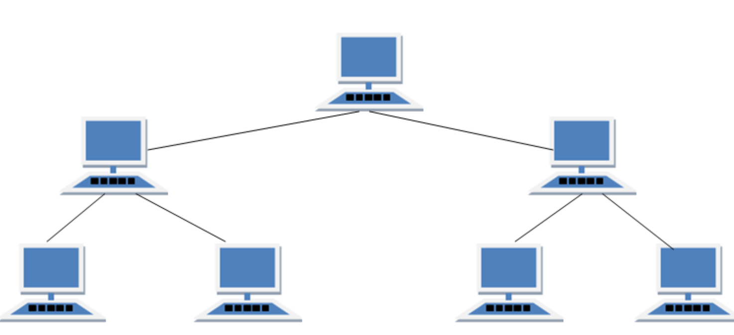
Network Topologies
Tree – multiple ‘Star’ networks connected to a backbone link (bus-like)
  Pros:
    Scalable & manageable
    Failure isolation
    Hierarchical management
  Cons:
    Points of failure
    Complex
  Usage:
    Large organizations
    e.g. campus – each building is a cluster (connected by a backbone link)
https://www.lifewire.com/computer-network-topology-817884

Slide 6
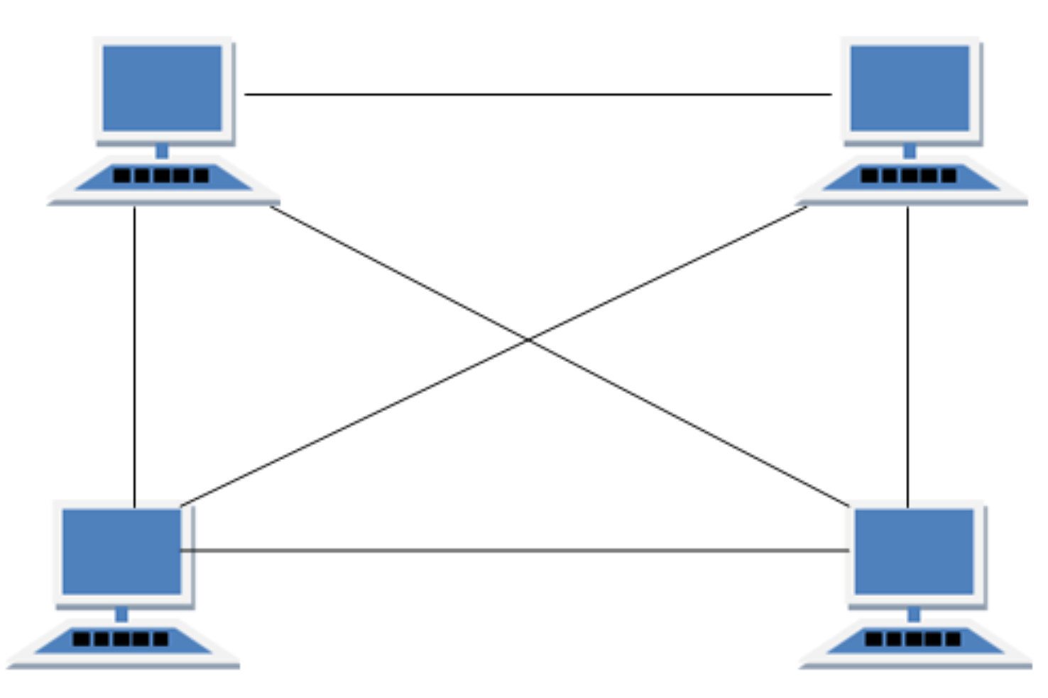
Network Topologies
Mesh – interconnections, multiple routes from source to destination
  Each to each – full mesh
  Each to some – partial mesh
  Pros:
    Highly reliable
  Cons:
    Expensive
    Complex (~n² connections)
    Hard to maintain
  Usage:
    Datacenters
    ISPs
    Military & emergency networks
https://www.lifewire.com/computer-network-topology-817884

Slide 7
OSI Model
Open System Interconnection – networking framework
  Networking is complex, OSI layers provide structure
Protocols – communication rules
7 - Application
Provides networking to applications/APIs
e.g. HTTP, FTP, POP3, DNS
High level
FTP, HTTP, etc
6 - Presentation
Translate data into transferable format including compression, encryption, encoding
e.g. HTTPS encrypts traffic with TLS, Unicode -> ASCII for URL
5 - Session
manages sessions, ensures communication continuity; keep a session alive
e.g. NetBIOS, PPTP (VPN)
4 -Transport
Provides reliability & order OR fast delivery; split data into “larger packets”
e.g. TCP (segments), UDP (datagrams)
3- Network
data routing; breaks data into packets
e.g. IPv4, IPv6
Low level
TCP/IP, Token Ring
2 - Data Link
Data transfer between devices in the same network; breaks packets into frames
e.g. Switch, network card
1- Physical
Data carrier
e.g. Ethernet cable, Wi-Fi signal
https://en.wikipedia.org/wiki/OSI_model

Slide 8
OSI Model Example
Browser opens rit.edu
  Resolve the domain → IP address: DNS – Layer 7 (Application)
  TLS handshake & data encryption: TSL – Layer 6 (Presentation)
  Connection / session with RIT server is established: Layer 5 (Session)
  Data is split into segments that are numerated & sent: TCP – Layer 4 (Transport)
  Segments are split into packets that are routed from the source IP to the target IP: IP – Layer 3 (Network)
  Network device split packets into frames: Layer 2 (Data Link)
    & uses devices MAC addresses
  Bits move though physical cables: Layer 1
  On the target side – opposite process
    Bytes → frames → packets → segments → data → decryption → HTTP request → handling

Slide 9
Protocols Aid in API Creation
Protocols = rules of communications; format defines the contract
  Format must be followed; actual content varies according to the problem
  Each layer exposes an interface to the layer above — every layer has an API
Traditionally: "API" = application-level interface built on top of Layer 7
User application is not a layer
  e.g. FileZilla (FTP client) uses FTP; FTP is the Layer 7 protocol

Slide 10
Impact on Software architecture
Distribution of components
  Each network hop adds latency — network layout is an architectural decision
  Protocol layer transitions add overhead (packet split / recovery, encryption / decryption)
  Firewalls add latency and may block traffic — necessary tradeoff for security
  Network segmentation adds security but increases hops & complexity
Distributed systems introduce a fundamental scalability vs. performance tradeoff
Management of components
  No control over remote components & connections — failures must be designed for
Failure management strategies
  Retry — but beware idempotency (duplicated requests) and knowing when to stop
  Exponential backoff — increase delay between retries to avoid overloading a struggling service
  Fail fast — return an error immediately rather than waiting; but verify the request wasn't already executed
  Circuit breaker — stop calling a failing service; allow recovery before retrying
  Fallback — degrade gracefully when a dependency is unavailable
  Chaos monkey — reliability should be engineered, not assumed

Slide 11
Impact on Software architecture
API management
  Define what is exposed vs. hidden — the public contract
  Versioning — which version handles a request during transition?
    Logic, entities, and DB structures must coexist
  Authentication — who is allowed to call the API?
Protocol choice is an architectural decision
  HTTP — simplicity & readability
  gRPC — performance
  SOAP — strictness / formal contracts
Encryption — required for any API crossing a trust boundary

Slide 12
Simple Network Applications
(almost) Earliest network applications - Email & FTP
Let’s see these concepts in action at the protocol level …
We’re going to go ‘bare metal’ and use telnet
  A simple text-based utility running on top of TCP
  ‘Teletype Network’

Slide 13
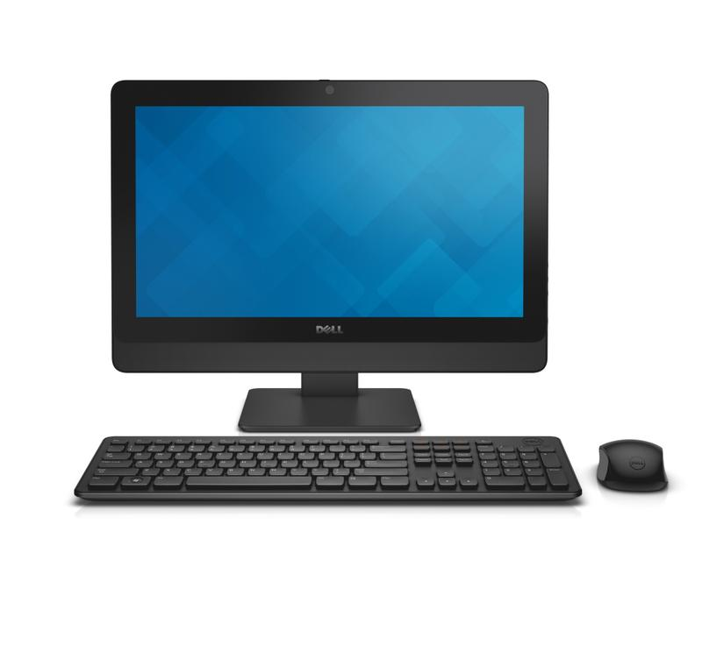


Email -- Send
Sending an email relies on the SMTP (Simple Mail Transfer Protocol)
  Multiple steps inside
When you click 'Send'
  Message is wrapped in the SMTP format
    e.g. headers - sender, recipient
  Message is encoded and sent to your local SMTP server
  Recipient domain is extracted
  DNS server is located to find the receiving domain
  Message is sent to the domain
  Domain Server locates the receiving SMTP server
  Email is stored on the receiving SMTP server
ritchie@rit.edu
SMTP Server
DNS
ritchie@rit.edu
Domain Server
Receiving SMTP Server
Pull email: POP or IMAP

Slide 14
Protocols: Text based
Basically, open a port, send commands
> telnet
> open mymailserver.smtp.com 25 //the port
> EHLO mydomain.com
> MAIL FROM: kalrabb@mydomain.com
> RCPT TO: sendto@theirdomain.net
> DATA <….>
https://docs.microsoft.com/en-us/Exchange/mail-flow/test-smtp-with-telnet?view=exchserver-2019
EHLO vs HELO: Indicates level of RC support (EHLO is newer)
The sender; errors will return to this email address
Recipient(s); can be issued multiple times
Mail content, including header fields
Subject:
- To:
- cc:
<CRLF> to end headers
‘.’ to end data
RFC 5321 - Simple Mail Transfer Protocol (ietf.org)

Slide 15
With RIT server
RITs mail relay for SMTP is smtp-server.rit.edu
Can use HELO or EHLO
Need to be within RIT network when using it
Only accepts rit email senders (?)
Different SMTP servers have different rules for sequence of commands, authentication rules and controls around who can use them

Slide 16
With mymail.rit.edu
> telnet mymail.rit.edu 25
HELO
250 ex04mail01a.ad.rit.edu Hello [74.74.135.96]
MAIL TO:
kalrabb@gmail.c501 5.5.4 Unrecognized parameter
om
500 5.3.3 Unrecognized command
MAIL FROM: kalrabb@rit.edu
500 5.3.3 Unrecognized command
RCPT
500 5.3.3 Unrecognized command
MAIL FROM: kalrabb@rit.edu
250 2.1.0 Sender OK
RCPT TO: kalrabb@gmail.com
550 5.7.1 Unable to relay
RCPT TO: <kalrabb@gmail.com>
550 5.7.1 Unable to relay
RCPT TO: kalrabb@rit.edu
250 2.1.5 Recipient OK
DATA
354 Start mail input; end with <CRLF>.<CRLF>
This is test line only
Subject: test subject
.
250 2.6.0 <01d75957e0fc44cfb2aa20c9e154a8a9@ex04mail01a.ad.rit.edu> [InternalId=113528870540153, Hostname=ex04mail01d.ad.rit.edu] Queued mail for delivery
QUIT

Slide 17
Extending Email
Email was created with text data in mind
  Cat memes didn’t exist anyway
Solution – MIME (Multi-part Internet Mail Extensions)
  Allows encoding non-text data (e.g., binary)
  Allows multiple items
  Email as a container
    Attachments!
  Also used for HTTP data transfer
    e.g, Content-Type: image/jpeg ← MIME

Slide 18
Exploring Network Protocols
Assignment:
- Using telnet command line, you will connect to and send email via SMTP (use mymail.rit.edu)
- Using the command line, you will connect to and send a file via FTP (https://docs.microsoft.com/en-us/windows-server/administration/windows-commands/ftp#:~:text=The%20ftp%20command-line%20parameters%20are%20case-sensitive.%20This%20command,sub-environment%20in%20which%20you%20can%20use%20ftp%20commands.)
Using FTP to seappserver3.rit.edu, upload a text file containing your smtp command history for sending an email. Use anonymous login

Slide 19
Appendix
History, Review, and other stuff

Slide 20
Condensed Network History
1961 – idea of ARPANET (paper “Information Flow in Large Communication Nets”)
  idea of packet switching -> modern internet
1966 – ARPANET development started
1969 – ARPANET is launched (first 2 nodes)
1969 – first RFC RFC 1: Host Software
1969 – “pre-router”
1970 – NetWare Core Protocol is created
  file sharing / access, printing, auth, etc
1971 – first email is sent
1973 – Ethernet is developed
1976 / 1978 – first routers are created

Slide 21
Condensed Network History
1978 – TCP/IP
1981 – IPv4 – RFC 791
1983 – ARPANET works on TCP/IP
1983 – DNS is created
1988 – WaveLAN (precursor to Wi-Fi)
1988 – firewall idea
1990 – first switch
1996 – IPv6 (still not there)
1997 – 802.11 (modern Wi-Fi, up to 2 Mbps)

Slide 22
Condensed Network History
1999 – WEP (Wi-Fi encryption)
2003 – 802.11g (up to 20 Mbps)
2009 – 802.11n (5 GHz)
2011 – 4G LTE => smartphone boom
2014 – HTTP/2 (shared connections, non-blocking requests)
2015 – Wi-Fi 5 (Gbps)
2020 – 5G (low latency (to 1ms) => IoT, autonomous vehicles, AR/VR)
2020 – HTTP/3 (always encrypted, better on unstable networks)
2021 – Wi-Fi 6 (dense environments – airports, stadiums)
2024 – Wi-Fi 7 (40+ Gbps, AR/VR, 8k streaming, metaverse)

Slide 23
Networking Terms
Domain Name System (DNS)
  Translates Internet addresses to IP addresses (nslookup google.com)
    → know what computer to reach
  DNS-servers
    13 root servers
      Store referrals for top-level domains
        For .edu ask this server
    TLD (top-level domain) servers
      Knows which domain belongs to which authoritative server
    Authoritative servers
      Own domains
    Recursive resolvers
      Local ISPs, Google 8.8.8.8, Cloudflare 1.1.1.1
      Cache & ask
  Update delays (a lot is cached) → cannot switch instantly → some traffic flows to old servers

Slide 24
Networking Terms
Dynamic Host Configuration Protocol (DHCP)
  Automatically assigns IP addresses to the devices on a network
  From a pre-configured range of allowable IP addresses
  Avoid conflicts for self-appointed IPs
  Computer joins a network
  Computer sends a broadcast 255.255.255.255:67 – who is a DCHP server here?
    255.255.255.255 – to every computer in the network
  DHCP server replies with an available IP-address
  Computer confirms

Slide 25
Networking Terms
Ethernet
  Set of networking standards for wired networks
  There are alternatives:
    Fiber-optic links
    Power line communications (via electrical network)
    Coaxial cables
    etc
  Most used
  Faster than Wi-Fi
  More reliable than Wi-Fi
  Cables ☹

Slide 26
Networking Terms
Virtual Private Network (VPN):
  Creates a secure channel between 2 networks
  Networks think they are the same
  Encrypted - Outsiders do not see what’s in the channel
  Usage
    Connectivity across branches
    ATM to bank
    Personal privacy / security in public networks
    Regional restrictions (mask the output point)
    Censorship avoidance
    Torrents
  Not anonymous!!!
    Private VPN-servers hold logs (almost all of them)
    Don’t use for piracy, of course

Slide 27
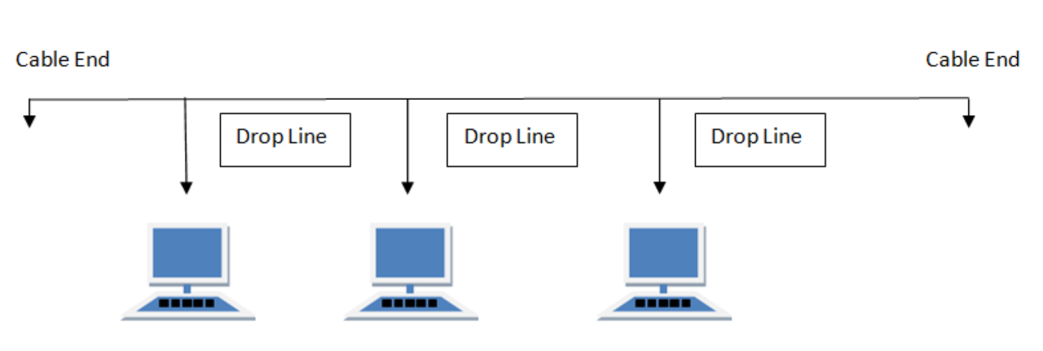
Networking Architecture Terms (Legacy)
Bus - common backbone to connect all devices (like a hardware bus). Signals in both directions
  Pros:
    Simple & cheap
  Cons:
    1 failure → network is gone
    Collisions
      2 devices transmit towards each other
      Signal interference
      Impossible to decode
  Usage:
    Early Ethernet
https://www.lifewire.com/computer-network-topology-817884

Slide 28
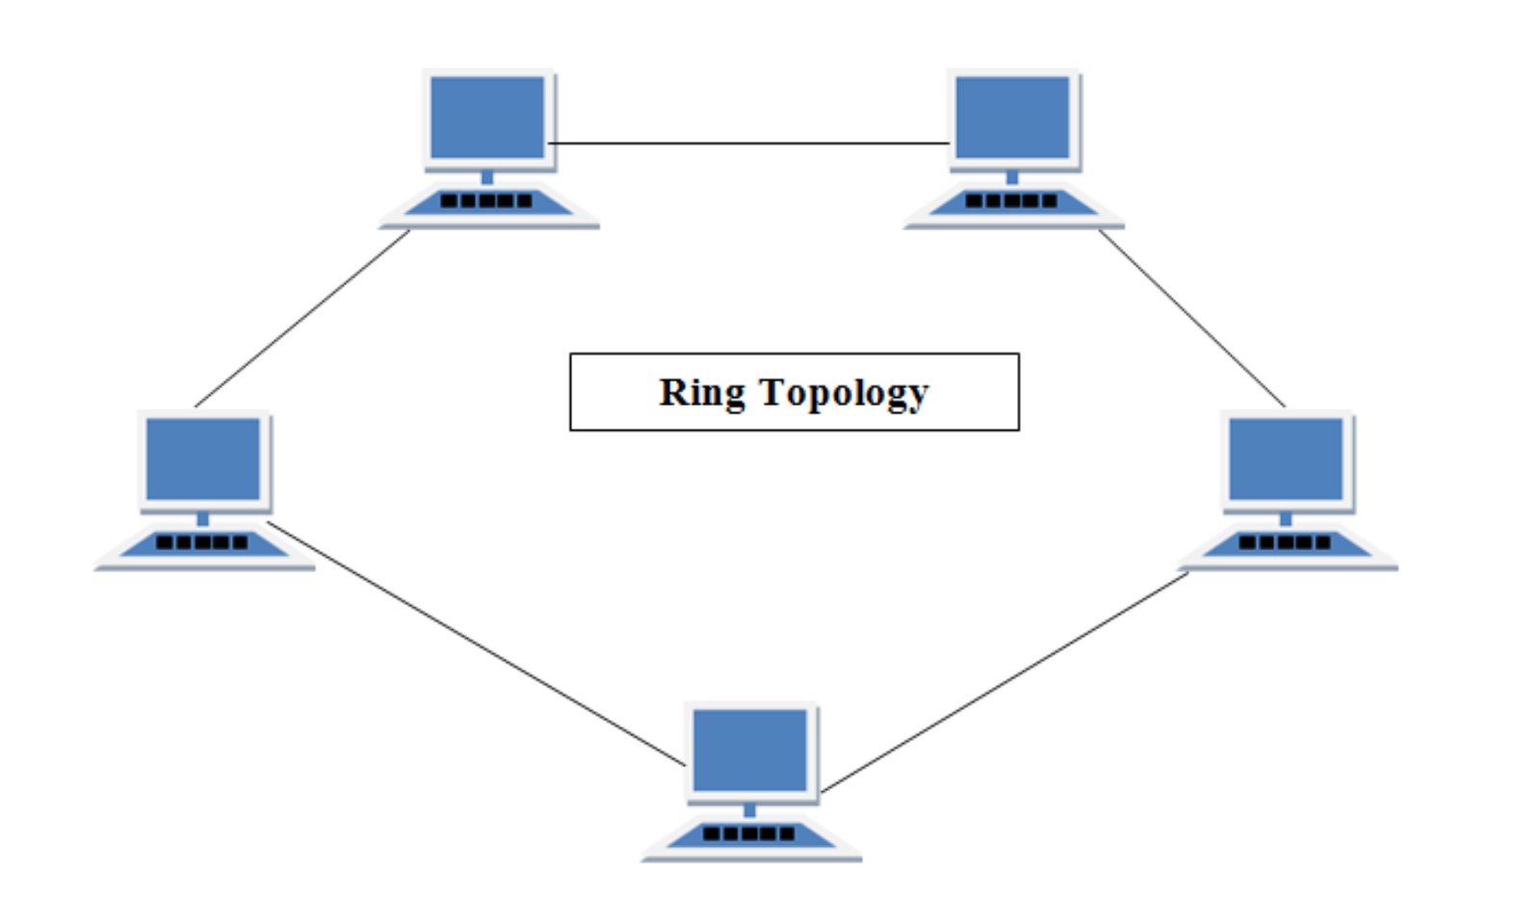
Networking Architecture Terms (Legacy)
Ring - Messages travel through a ring in the same direction
  Pros:
    Simple & cheap
    No collisions (same direction signals)
  Cons:
    1 failure → network is gone
  Usage:
    Some organizations in 80s-90s
    Dual rings for fault tolerance
https://www.lifewire.com/computer-network-topology-817884

Slide 29
Who still uses FTP?
Everyone (almost) … you just can’t see it
Example:
MOVEit – enterprise file transfer software
  2023 – security breach
  web UI – unavailable
  FTP / SFTP - works
The local article
University of Rochester investigating data breach - WHEC.com
The details
MOVEit Transfer customers warned of new flaw as PoC info surfaces (bleepingcomputer.com)

Slide 30
The secrets of RFCs
The third step in the procedure is the DATA command. DATA <CRLF> If accepted, the receiver-SMTP returns a 354 Intermediate reply and considers all succeeding lines to be the message text. When the end of text is received and stored the SMTP-receiver sends a 250 OK reply. Since the mail data is sent on the transmission channel the end of the mail data must be indicated so that the command and reply dialog can be resumed. SMTP indicates the end of the mail data by sending a line containing only a period. A transparency procedure is used to prevent this from interfering with the user's text (see Section 4.5.2). Please note that the mail data includes the memo header items such as Date, Subject, To, Cc, From [2].
https://www.rfc-editor.org/rfc/rfc821#page-19
This specification permits multiple occurrences of most fields. Except as noted, their interpretation is not specified here, and their use is discouraged. The following syntax for the bodies of various fields should be thought of as describing each field body as a single long string (or line). The "Lexical Analysis of Message" section on "Long Header Fields", above, indicates how such long strings can be represented on more than one line in the actual transmitted message. message = fields *( CRLF *text ) ; Everything after ; first null line ; is message body
https://www.rfc-editor.org/rfc/rfc822#section-4.1

